Slide 1


DEVELOPMENT OF A FRAMEWORK TO MEASURE THE IMPACT OF EVENTS
Prof Kamilla Swart
March 2016

Slide 2
Introduction
Events important element in tourism marketing
Various national tourism strategies emphasise role events play to develop tourism
Many purported benefits BUT methods of measuring & evaluating impacts vary
NDT Lekgotla (2012) requested research be conducted to develop a standardised framework to assess event impacts

Slide 3
Introduction…cont.
Problem: currently no standardised methodology exists to assess types of impacts on a range of events of different types and sizes
  Where studies exist, focus on economic impacts
Purpose: To develop a standardised framework to measure, monitor and manage the impacts of events of different types and sizes in South Africa

Slide 4
Introduction…cont.
  Phase One (2013-2014): reviewing literature, accompanying models and approaches of evaluating events and identifying relevant indicators to measure impact of events
  Phase Two (2014-2015): finalising development of indicators, piloting and evaluating five events of different sizes, spread across Provinces
  Phase Three (2015-2016): developing, piloting and finalising framework for implementation
    Capacity building of NDT and provincial officials in utilising framework
    Development of training manuals for implementation and workshop facilitation

Slide 5
Phase 1: Literature review

Slide 6
Event tourism
Systematic planning, development and marketing of planned events as tourist attractions
Significant benefits for place marketing, image making, and development (Getz, 1997)
Categories of events:
  Mega-events
  Hallmark or iconic events
  Major events
  Local or community events

Slide 7
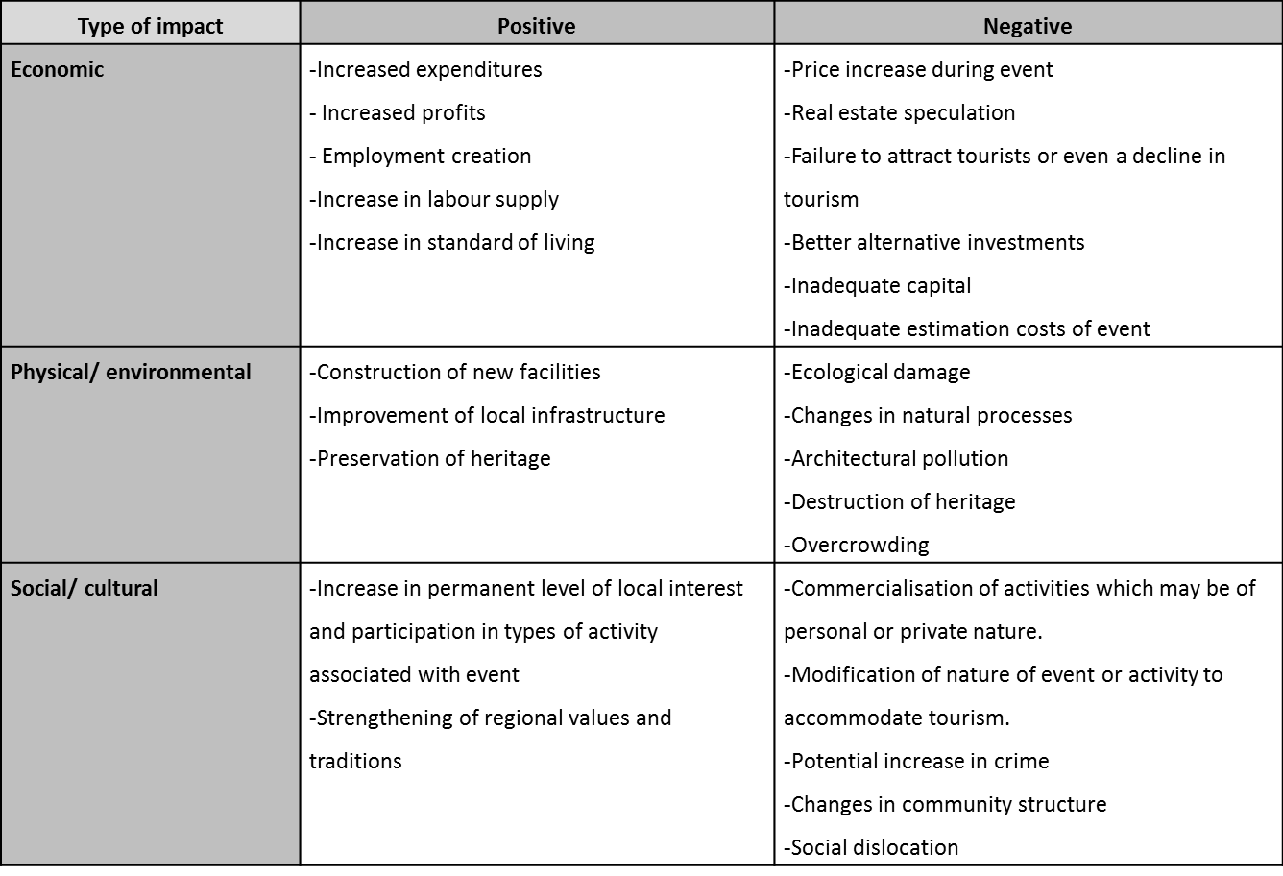
Event impacts

Slide 8
Event impact assessment
Approaches
Models
Sport Tourism Economic Assessment Model (STEAM)
Olympic Games Impact (OGI) Study
UK Sport EventIMPACTS
Sport Event Impact Model (SEIM)
Global Sports Impact (GSI) Project
Economic
Social
Environmental
Media

Slide 9
Research approaches in SA
Direct economic impact assessment most commonly used
  Very few studies calculate indirect impacts (multipliers)
Social impact studies conducted in few provinces
2010 FIFA World Cup™ studies conducted in various provinces
  SEIM
  Media impact

Slide 10
Phases 1 – 2: Development of indicator framework

Slide 11
Indicator development process
Definition
Criteria
Comprehensive and cover range of impacts
Informed by literature
Themed by type of impacts
Consider different type of events
Prioritised

Slide 12
Indicators developed
Five key thematic impacts have been grouped
  Economic/ financial
  Social
  Environmental
  Event-sector specific
  Event planning and management (governance)
Indicators for a specific event or event types will differ and need to be selected:
  Type of event
  Objectives of specific event being evaluated
Indicators have been prioritised
  High: Must be done
  Medium: Depends on type of event and resources available
  Low: may be difficult to access information

Slide 13
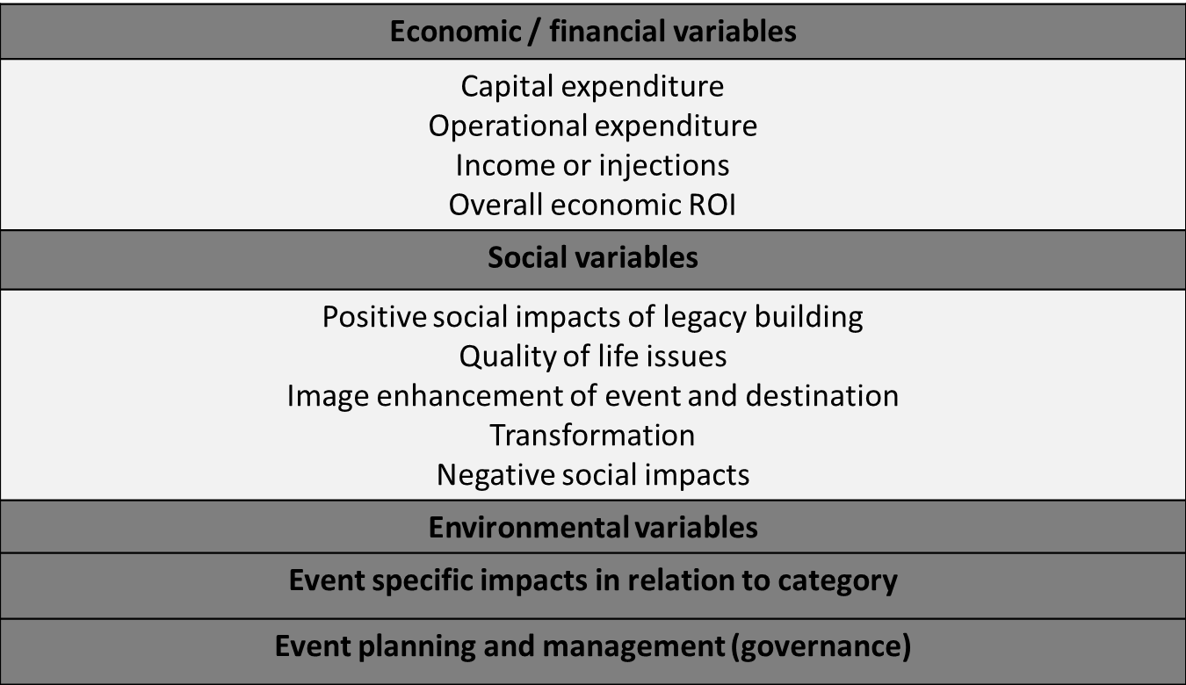

Slide 14
Phase 3: Pilot & Finalising Framework

Slide 15
Pilot survey instruments
Indicators used to develop instruments
Ensure instruments appropriately developed
  Attendee survey
  Event organiser (EO) survey
Assessed construction of questions
Whether methodological approaches are appropriate
Interviews conducted within reasonable timeframes

Slide 16
Pilot survey instruments…cont.
Attendee survey
Attendee profile
Event attendance and consumer behaviour
Travel, accommodation and spend
Knowledge and perceptions of event and destination
  Including environmental questions
Demographic profile

Slide 17
Pilot survey instruments…cont.
EO survey
Organiser profile
Budget and expenditure
Employment and skills development
Responsible tourism
Organisation of event
Satisfaction with event

Slide 18
Pilot survey instruments …cont.
Conducted at World Congress for Psychotherapy
  Durban (KZN) - 28th & 29th August 2014
Conducted at McGregor Food & Wine Festival
  McGregor (Western Cape) - 30th August 2014
Developing templates for data inputting using SPSS & generating tables
Undertaking economic impact analysis
Finalising process report to refine instruments

Slide 19
Event evaluations
Sampling framework developed
Data collection concentrated at main event venues
Systematic, spatially-based purposive sampling approach
Attendee sample size determined by no. of attendees
EO questionnaire mailed to EO post-event
Economic impact conducted by economist
  Economic contributions made by two main event stakeholders

Slide 20
Description of events
EVENT | PROVINCE | TYPE | SIZE | DATE
VDF | Free State | Sport/Adventure | Large | 31 Oct – 1 Nov 2014
WPC | KwaZulu-Natal | Conference | Small | 3-8 Nov 2014
MCQP | Western Cape | Lifestyle/Fancy Dress Party | Large | 20 Dec 2014
TCH | Gauteng | Sport/Triathlon | Medium | 15 Feb 2015
MF | Limpopo | Lifestyle/Music | Large | 26-28 Feb 2015

Slide 21
Targeted sample vs. actual sample
 | WPC (n=91) |  | VDF (n=310) |  | MCQP (n=300) |  | TCH (n=200) |  | LMF (n=300)
 | T | A | T | A | T | A | T | A | T | A
Attendees | 100 | 91 | 300 | 310 | 300 | 300 | 200 | 200 | 300 | 300
EO | 1 | 1 | 1 | 1 | 1 | 1 | 1 | - | 1 | 1
Note:
T: targeted sample; A: actual sample
1202 attendees surveys
All EOs responded (4) except one

Slide 22
Key Findings

Slide 23
Attendee numbers by category
 |  | Overnight visitor/ tourist | Day-visitors | Local resident | Total
VDF | Sample | 64 | 63 | 183 | 310
 | % | 20.65 | 20.32 | 59.03 | 100
 | Total | 1652 | 1626 | 4722 | 8000
TCH | Sample | 25 | 118 | 57 | 200
 | % | 12.5 | 59 | 28.5 | 100
 | Total | 625 | 2950 | 1425 | 5000
WPC | Sample | 57 | 4 | 30 | 91
 | % | 62.64 | 4.4 | 32.97 | 100
 | Total | 269 | 19 | 142 | 430
MCQP | Sample | 45 | 19 | 236 | 300
 | % | 15 | 6.33 | 78.67 | 100
 | Total | 1226 | 517 | 6429 | 8172
LMF | Sample | 83 | 44 | 173 | 300
 | % | 28 | 15 | 58 | 100
 | Total | 5685 | 3014 | 11849 | 20547

Slide 24
Attendee average spend in categories
 | WPC (n=91) | VDF (n=310) | MCQP (n=300) | TCH (n=200) | LMF (n=300)
Tickets | R9 152.17 | R972.15 | R476.48 | R1725.45 | R248.46
Food/ beverages | R2 285.98 | R470.91 | R601.08 | R374.54 | R545.01
Event-related articles | R901.74 | R276.91 | R39.47 | R532.5 | R91.32
Shopping | R2 062.78 | R428.88 | R195.96 | R336.67 | R195.96
Transportation | R4 418.25 | R418.34 | R874.22 | R278.16 | R493.93
Accommodation | R8 790.22 | R1 684.57 | R601.89 | R1118.18 | R1 077.80
Other expenditures | R1 865.00 | R275.47 | R259.03 | R20.00 | R66.50
Overall spend | R16 050.46 | R1 813.13 | R3 358.01 | R2649.31 | R2 919.49

Slide 25
Budget for event in categories
 | WPC (n=1) | VDF (n=1) | MCQP (n=1) | LMF (n=1)
Overall spend | R2 million | R607 141 | R2 765 158 | R6.5 million
Capital expenditure (e.g. facilities, equipment, infrastructure, etc.) | R70 000 | R343 079 | - | R2 500 000
Venue hire | R630 000 | R85 450 | R273 500 | R150 000
Salaries and wages | R200 000 | R52 170 | R405 500 | R200 000
Advertising and marketing (include media and broadcasting costs) | R350 000 | R45 839 | R627 100 | R680 000
Travelling and accommodation | R650 000 | - | R251 200 | R250 000
Translation services and equipment | R400 000 | - | - | -
All other costs | - | - | R1 207 858 | R2 720 000

Slide 26
Economic impact
 | VDF | TCH | WPC | MCQP | LMF
Visitor expenditure | R4 231 105 | R4 958 504 | R2 313 753 | R7939 003 | R29 292 115
Organiser expenditure | R526 538 | - | R1 975 000 | R6 500 000 | R6 375 000
Direct impact | R4 757 643 | R4 958 503 | R4 288 754 | R10 578 561 | R35 667 116
Total impact (low) | R5 233 408 | R5 454 353 | R4 717 629 | R11 636 417 | R39 233 827
Total impact (high) | R6 660 701 | R6 941 904 | R6 004 255 | R14 809 985 | R49 933 962

Slide 27
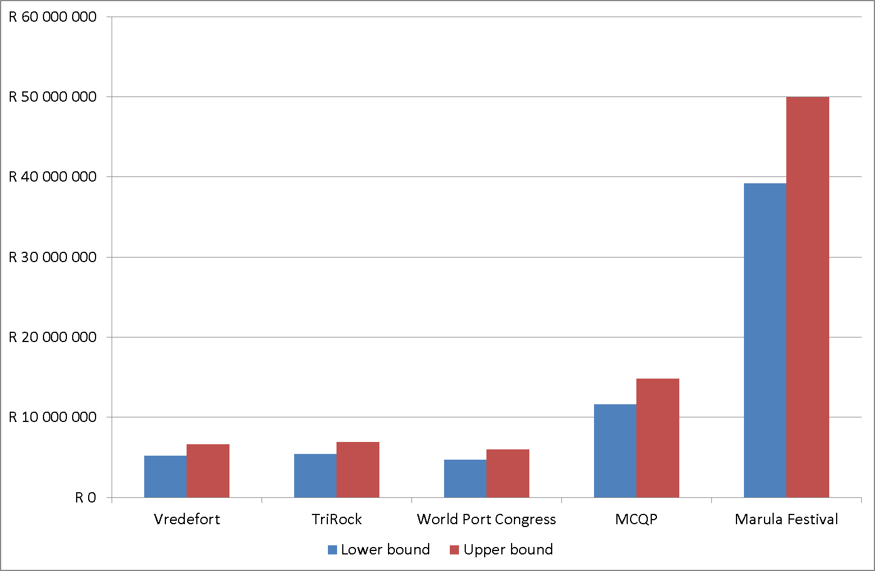
Total economic impact

Slide 28
Conclusion
Standardised methodology
  Make diverse events comparable
  Permits comparison of economic impact across events
Attendees and EOs surveys sufficient to undertake economic impact assessment
Vital EOs provide financial data as required
Important for calculating public multiplier which was weakest aspect of analyses
  Due to lack of public spend being declared across events

Slide 29
Conclusion
Current survey instruments provide data to assess TBL initially envisioned
Pre-event planning and co-operation of EO critical to sampling framework and ensuring timeous accreditation access
Provinces play important role in facilitating access
Incompletion of EO survey impacts economic impact calculations as EO only stakeholder provide information about event expenditure and (local) services procured
Basis of proposed Event Evaluation Framework
  Provide more strategic approach to evaluate NDT and/or Provincially-supported events in consistent manner
  Assess impact of events on tourism sector
  Justify funding for events from public and private sectors

Slide 30
Simplify and standardise approach
Assess impact of events of different types and sizes in different localities
Account for different types of impacts
Improve data collection to ensure relevance, quality, validity and accuracy of data
Permit comparisons between events and track changes over time in relation to impacts of NDT and/or Provincially-supported events
Standardise return on investment (ROI) of economic impacts
Generate information that can assist in making decisions regarding which events should be supported or continued to be supported
Strategic orientation of Event Evaluation Framework is intended to:

Slide 31
Phase 3 of research project has resulted in:
Development of data collection instruments for event evaluation purposes that can be implemented across different types and sizes of events supported by NDT and/or Provinces
Development of indicators to inform Event Evaluation Framework
Development of a training manual for data collection instruments and sampling framework for primary data collection as well as for undertaking economic impact analysis

Slide 32
Key issues for consideration
If budget does not permit all NDT and/or Provincially-funded events to be evaluated, then sampling of different events be undertaken on annual basis
EO survey be completed to provide information on TBL aspects from EO perspective
Overall TBL assessment of event, attendee surveys must be included
Baseline information already in place, regular evaluations undertaken to track changes over time
NDT and/or Provinces identify target/flagship events evaluate on annual basis

Slide 33
Key issues for consideration
To ensure proposed Event Evaluation Framework is practical and implementable:
  Drafting of and/or revision of contracts to ensure compliance of EOs to provide information required
  Revised attendee and EO surveys including master template
Indicators should be revised on an annual basis
Need for continuous adaptation of Framework
Impacts can be ascertained event by event and longer term impacts examined annually

Slide 34
Roles and Responsibilities
NDT/ Provinces | Review baseline indicators and data collection instruments Screen and select events to be supported Work with research team to identify events to be sampled if all events are not being evaluated Ensure contractual obligation for EOs to provide information needed Project manage event evaluation deliverables
Event organiser | Completion of event organiser survey (especially in relation to financial information which affects economic impact calculation) and provision of all other event related information Provide and facilitate access to event venues which was a challenge in certain instances and affected reaching targeted samples
Event evaluation research team | Interpretation/ adaptation of baseline indicators and data collection instruments (in consultation with NDT and/or Provinces) Development and maintenance of data collection instruments Data collection and reporting Select and train fieldworkers, where applicable Calculation of economic data

Slide 35
Key issues for consideration
Likely to be several risks in relation to Framework implementation need to be addressed to ensure successful event impact evaluation:
  Commit resources for event impact evaluation, including adequately trained HR
  Ensuring compliance on part of EOs
  Ensuring quality data across all events monitored and evaluated
  Timely reporting (from EOs, NDT/Provinces and event evaluation specialists)
Proposed Framework provides when, how and who in relation to event supported by NDT and/or Provinces
Training Manual including data collection instruments (and SPSS templates for data inputting) available for implementation of finalised Framework

Slide 36
Recommendations
Cognisance of arrangements for research at events and consideration for partnership and collaboration to ascertain relevant data
Questionnaire-specific recommendations effected to revised survey instruments in training manual
Master template created and adapted for specific event requirements
Checked by trained tourism researcher (not just statistician)
Importance of trained fieldworkers and supervisors

Slide 37
Limitations
Challenge getting EOs to respond timeously
  Developing sampling framework and completing survey
Accessing precise economic data from EOs required
  Poorly completed in some instances
Ensuring higher response rates for all events evaluated in future
  Will limit bias and increases credibility, reliability and quality of data

Slide 38
THANK YOU
Kamilla Swart swartk@cput.ac.za

